Slide 1
Crop Production Analysis Report

Slide 2
Project Title - | Crop Production Analysis in India
Technologies - | Data Science
Domain - | Agriculture

Slide 3
Introduction
The Agriculture business domain, as a vital part of the overall supply chain, is expected to highly evolve in the upcoming years via the developments, which are taking place on the side of the Future Internet.
This paper presents a novel Business-to-Business collaboration platform from the agri-food sector perspective, which aims to facilitate the collaboration of numerous stakeholders belonging to associated business domains, in an effective and flexible manner.

Slide 4







Technologies Used –

Slide 5
KPI’s (Key Performance Indicators)
State Name – Name of the state where crop is grown.
Crop Year – Year in which the crop was grown
Season – Season of crop grown
Crop – The name of crop
Production – Unit of crops produce.

Slide 6
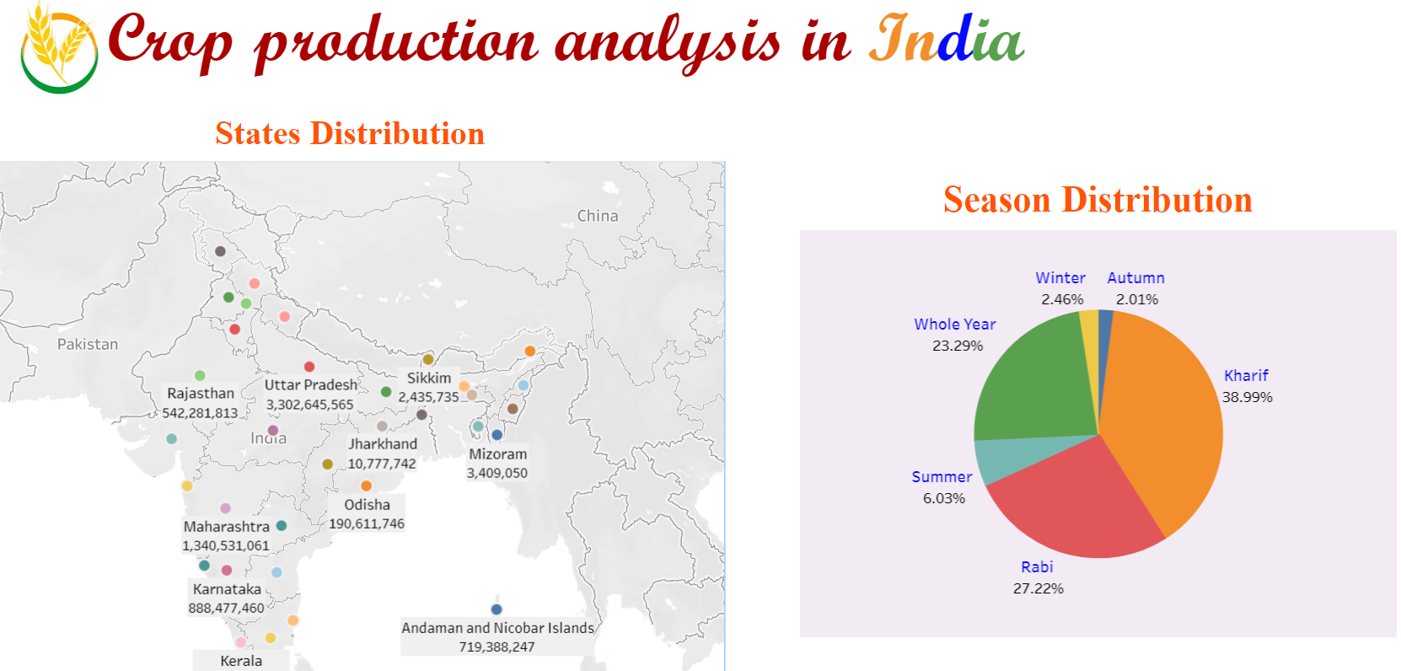

Slide 7
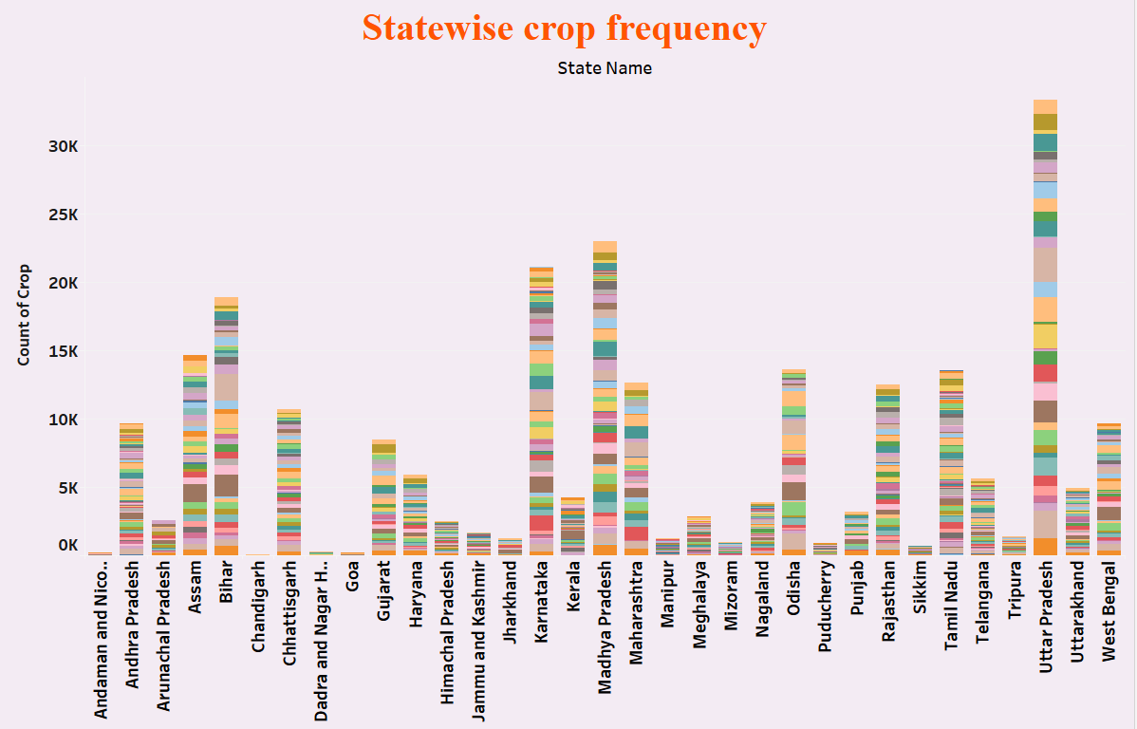

Slide 8
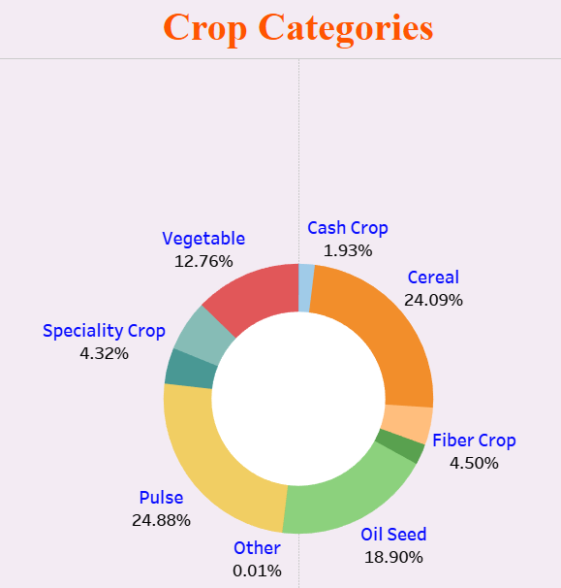

Slide 9
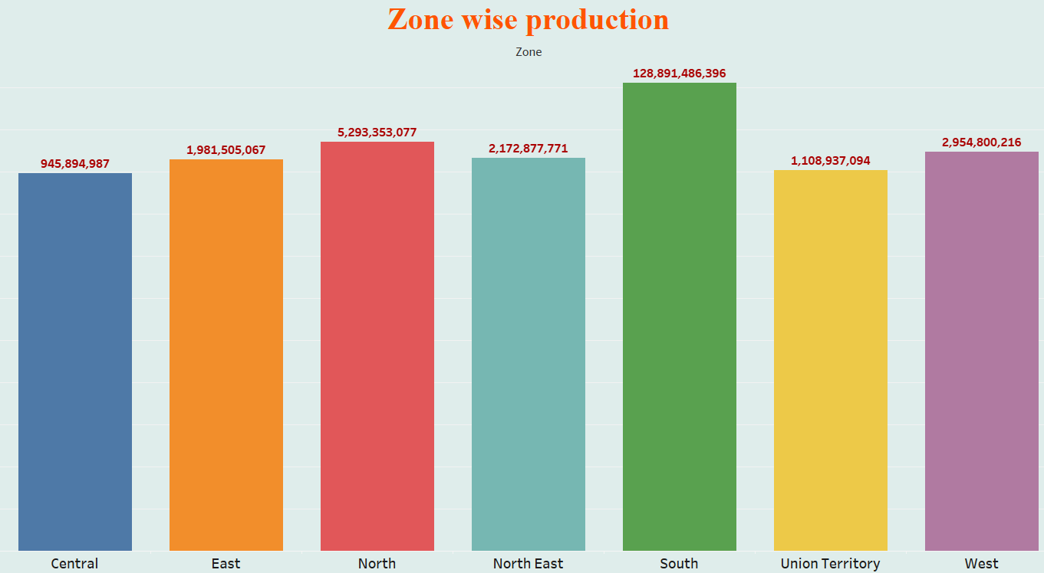

Slide 10
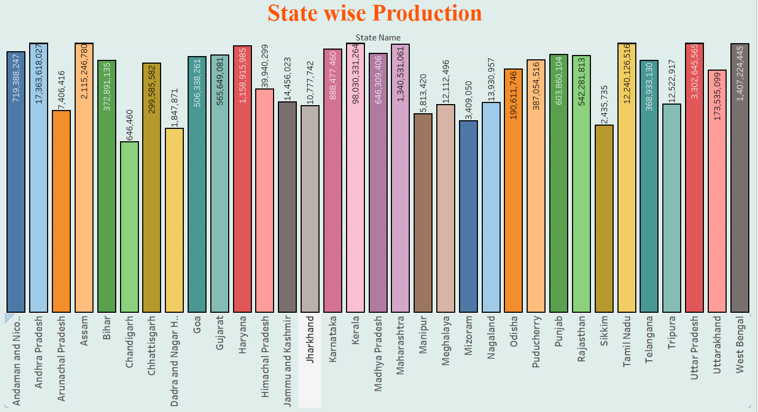

Slide 11
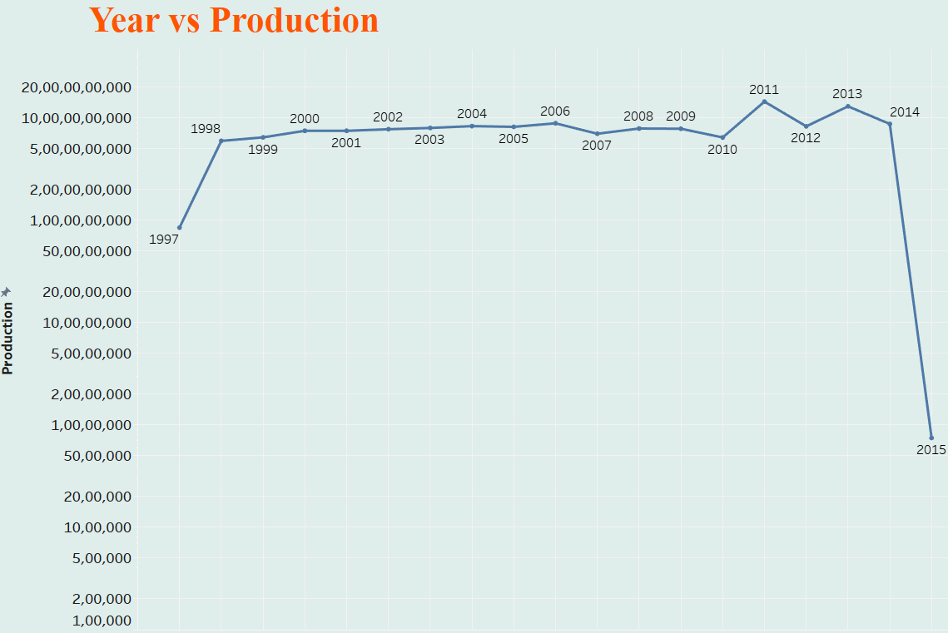

Slide 12
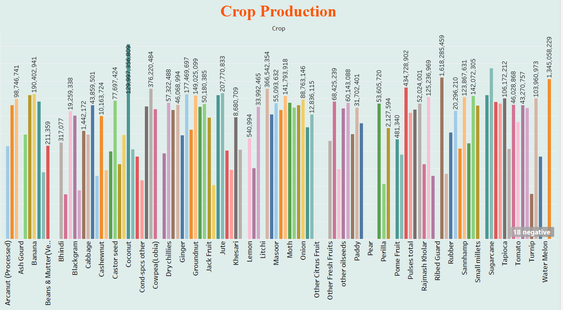

Slide 13
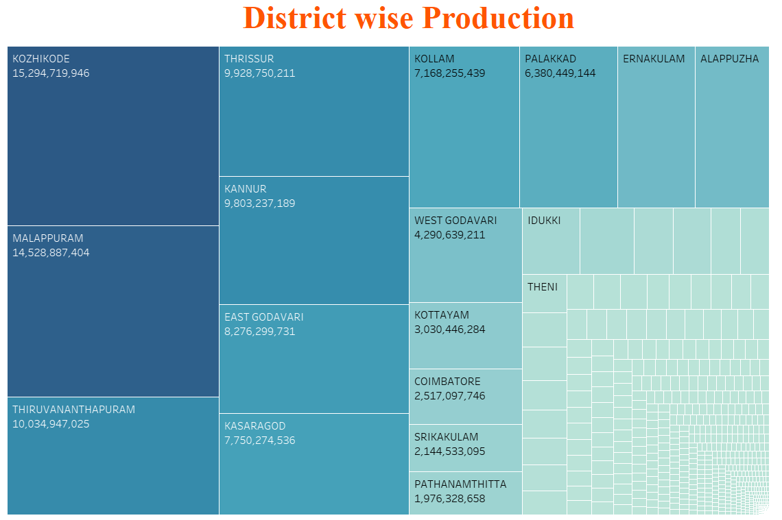

Slide 14
Thank you!

